Slide 1
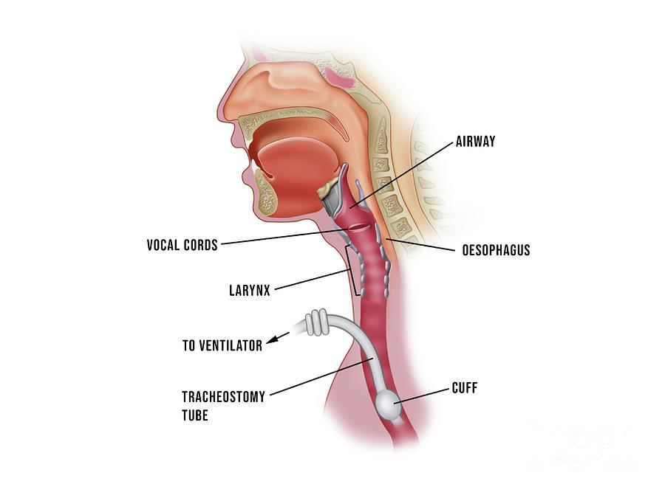
Ocean Medical Center
Early Tracheostomy and Late Tracheostomy Outcomes in Critically Ill Patients
Giuseppe Filice, MD; Premal Patel, MD; Cornelius Gallagher, MD; Satish Tadepalli, MD; Shakumar Patel, MD; Pramil Cheriyath, MD
Department of Internal Medicine, Hackensack Meridian Health Ocean Medical Center, Brick NJ
Background/Purpose:
Results
Recent studies have shown the beneficial effects of early tracheostomy over late tracheostomy in critically ill patients.
To date, most of the studies have used ICD-9 CM codes while looking for the differences in outcomes of early tracheostomy Vs late tracheostomy after intubation in critically ill patients.
Our objective of the study is to discuss the outcomes of early tracheostomy Vs late tracheostomy using ICD-10 CM codes from the most recent national database
Out of 139,395 patients, 57,320 (43.60 %) underwent an early tracheostomy, and 51.635 (39.28%) underwent a late tracheostomy.
In this cohort, 23,720 (41.38%) were females, 33,600 (58.62%) were men.
Among them, 34,365 (61.50%) were Caucasians, 11,260 (20. 15%) were African Americans, 5,535 (9.91%) were Hispanic, and 4,715 (8.44%) were native Americans in early tracheostomy group, 22,815 (44.19%) were Female, 28,820 (55.81%) were Men, 28,870 (57.79%).
Among them, Caucasians, 11,545 (23.11%) were African Americans, 5,445 (10.9%) were Hispanic, and 4,100 (8.21%) were native Americans in Late Tracheostomy group.
In the early tracheostomy group, the average length of stay is 27.8 (15-34) days and the financial burden for each patient is 101,141.2 (51189.9 -122, 900.6) USD and In-Hospital mortality is 10.83% compared to the late tracheostomy group, the average length of stay is 32.3 (20-37) days and the financial burden for each patient is 116, 047.8 (65, 823.1-138,876.5) and In-Hospital mortality is 13.44%.
Figure 3: Bar diagram showing gender and race distribution in the study population comparing the two group (Early Vs Late)
Methods
We conducted a retrospective cohort study using publicly accessible national Inpatient Sample (NIS) database from October 2015 to December 2017.
The NIS is a large publicly available all-payer inpatient healthcare database designed to produce U.S. regional and national estimates of inpatient utilization, access, charges, quality, and outcomes.
Its large sample size is ideal for developing national and regional estimates and enables analyses of rare conditions, uncommon treatments, and special populations.
Adult patients (>/= 18), who underwent tracheostomy procedures were included in the study.
Early tracheostomy group included the patients who underwent tracheostomy in <=7days after Intubation and Late tracheostomy group included the patients who underwent tracheostomy between 9 days to 16 days after intubation.
SAS 9.4 was used for analyses. SAS is a statistical analytical software suite developed by SAS Institute for data management.
 | Early Tracheostomy | Late Tracheostomy
Tracheostomy | 57,320 | 51,635
Female | 23,720 | 22,815
Male | 33,600 | 28,820
Caucasians | 34,365 | 28,870
African-American | 11,260 | 11,545
Hispanic | 5,535 | 5,445
Native American | 4,715 | 4,100
Figure 4: Bar diagram showing the average length of stay in two groups (Early Vs Late)
Figure 1: Table showing gender and race distribution in the study population
Figure 5: Pie chart showing in-hospital morality between the two groups (Early Vs Late)
Conclusion
Based on the results from our study, we found that early tracheostomized patients had better outcomes and less In-Hospital mortality and financial burden over late tracheostomized patients.
Figure 2: Anatomy of tracheostomy

